Slide 1
Movie Trends
Adam, David, neil, robin

Slide 2
Methodology
Wikipedia sourced for top movies from 1998 to 2018.
The OMDB API used to pull datapoints for each movie.
Rating (R, PG-13, PG, G)
Run Time
Critic Rating
Release Date
Box Office
Move Genre
Records were found for 2,792 total movies that included desired datapoints.
Other economic measures were brought in from public sources to compare to overall box office performance.

Slide 3

Summary
Economic Factors on Box Office Performance
Critic Score vs Box Office Success
Genre Impact on Critic Score vs Box Office Success
Rating (R, PG-13, PG, G) Trends
Seasonal Trends
Run Time Analysis

Slide 4
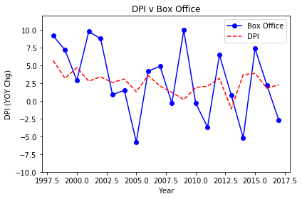
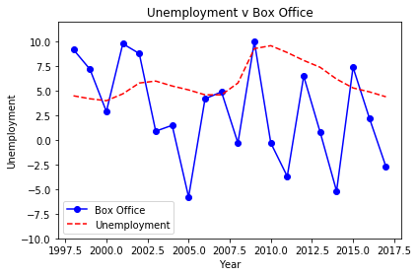
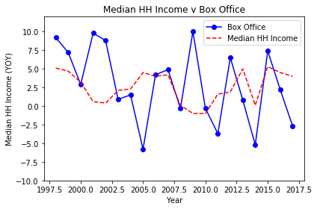
Economic factors
Hypothesis: Total boxoffice success is tied to economic indicators, like disposable income, unemployment, and median HH income.
Null Hypothesis: Movie boxoffice success is not dependent on disposable income, unemployment, or median HH income
Null hypothesis: While there are some years that DPI has a minor correlation,
it is likely other factors are driving box office success.
Sources: Box Office Mojo, an IMDB company, Organisation for Economic Co-operation and Development, Bureau of Labor Statistics
Notes:
There are some minor periods where DPI moves in the same direction as total box office revenue growth, it is not always the case (Ex: 2009 where DPI was low but YOY box office revenue was very high).

Slide 5
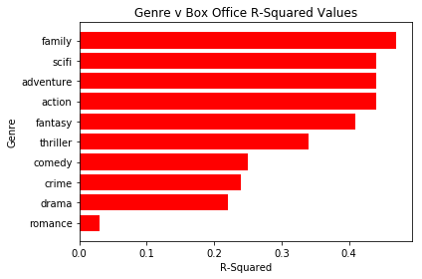
Movie Genres
Hypothesis: Correlation of critic score to box office success matters more for certain genres.
Null Hypothesis: There is no difference in correlation to critic ratings and box office success for various genres.
Methodology Note:
Genres are not mutually exclusive for individual films, as they may have more than one genre (Ex: Romantic Comedy). As such, each genre was evaluated individually and includes all films that have that genre listed within its list of genres.
Hypothesis: Some genres have a much better correlation of critic score to box office success
Source: OMDB, IMDB critic scores

Slide 6
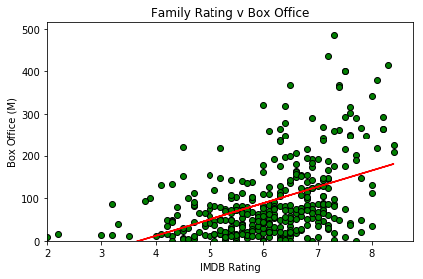
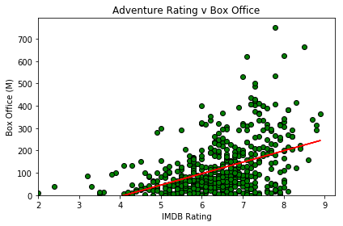
Movie Genres
Higher Correlation
Movies with a family, sci-fi, action, or adventure genre have a higher relationship of box office success when receiving higher critic scores.
Source: OMDB, IMDB critic scores

Slide 7
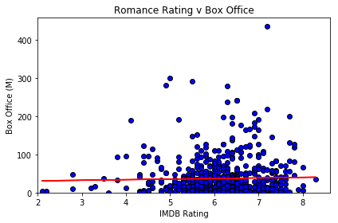
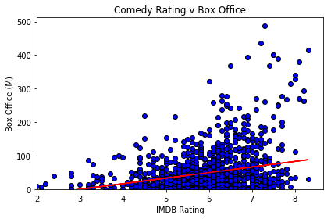
Movie Genres
Lower Correlation
Genres like romance and comedy have a much lower correlation of critic score to box office success. Perhaps other factors matter more for these films (Ex: actors, budget, etc)
Source: OMDB, IMDB critic scores

